Slide 1


Mastering Excel Formulas

Slide 2
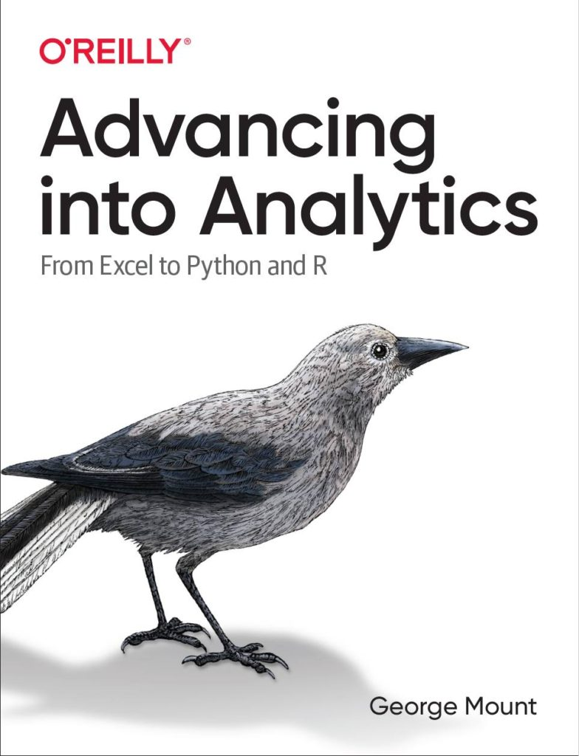


Hi, I’m George

Slide 3

Objectives for this session
Comfortably use formulas like SUMIFS and XLOOKUP
Design and audit complex, nested formulas
Look up data in an instant

Slide 4
Sections
Basics of formulas and functions
Formula design & audit
Conditional logic & formulas
Dynamic arrays
LET(), LAMBDA() and the future of Excel

Slide 5
Following along
Each section is a workbook
Solutions in separate workbooks
Follow along with demo notes

Slide 6
1. Basics of formulas and functions

Slide 7
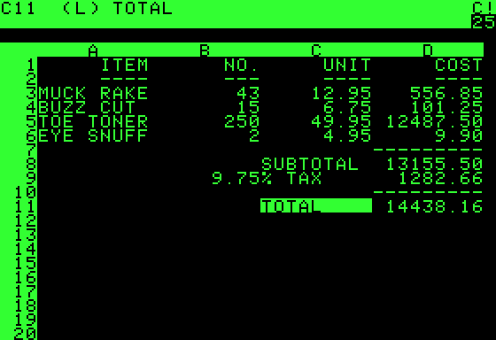
What is a formula?
User-designed equation
Usually starts with = (but doesn’t have to!)
https://en.wikipedia.org/wiki/VisiCalc
Notes:
Demonstrate in Excel how this works
Visi”Calc”

Slide 8
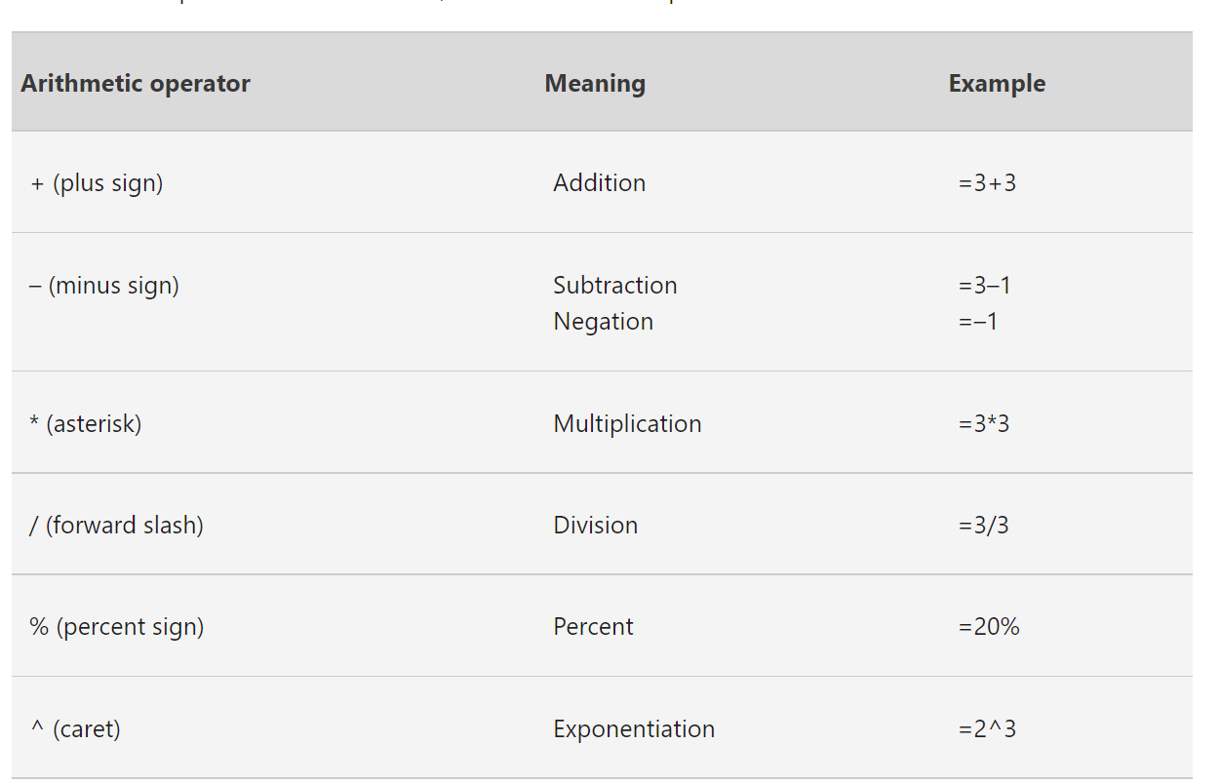
Numeric formulas
Follows the order of operations
https://support.microsoft.com/en-us/office/calculation-operators-and-precedence-in-excel-48be406d-4975-4d31-b2b8-7af9e0e2878a
Notes:
Demonstrate in Excel how this works
Visi”Calc”

Slide 9
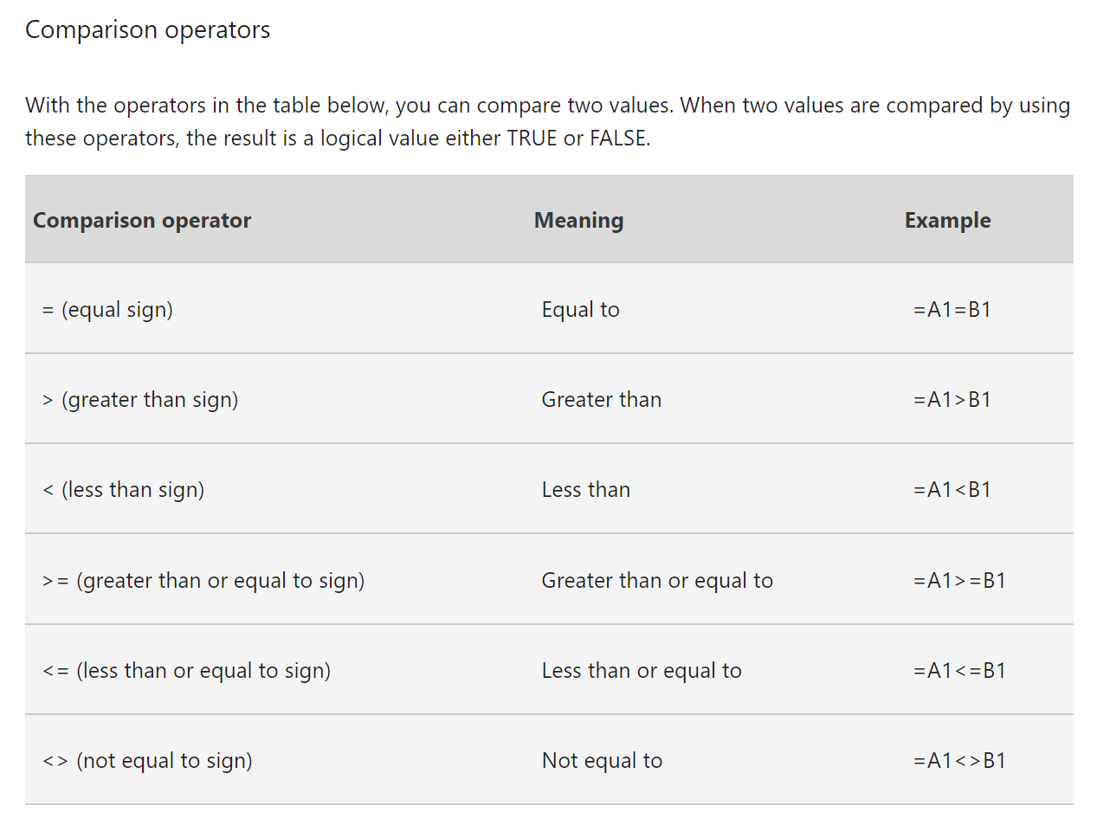
Comparison formulas
Useful for error-checking
https://support.microsoft.com/en-us/office/calculation-operators-and-precedence-in-excel-48be406d-4975-4d31-b2b8-7af9e0e2878a
Notes:
Demonstrate in Excel how this works
Visi”Calc”

Slide 10
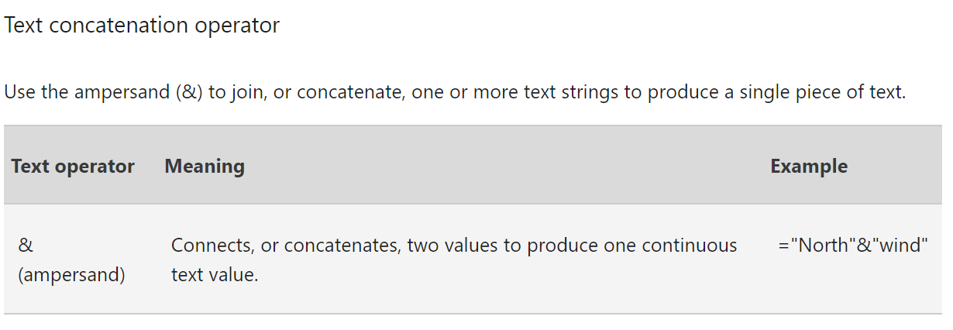
Text formulas
Small but mighty!
https://support.microsoft.com/en-us/office/calculation-operators-and-precedence-in-excel-48be406d-4975-4d31-b2b8-7af9e0e2878a
Notes:
Show how this works

Slide 11
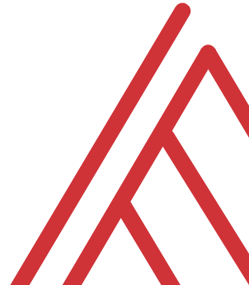
Questions?

Slide 12
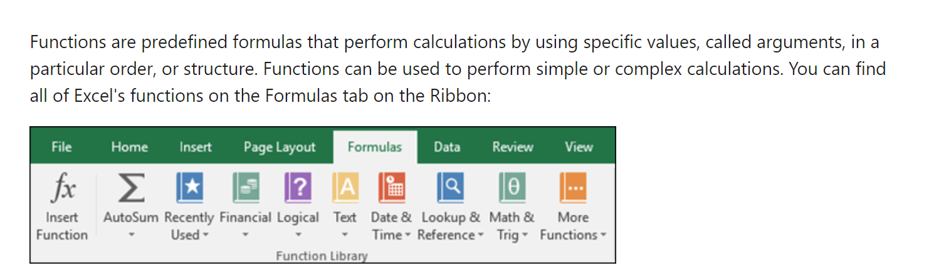
What is a function?
https://support.microsoft.com/en-us/office/using-functions-and-nested-functions-in-excel-formulas-3f4cf298-ded7-4f91-bc80-607533b65f02#:~:text=Functions%20are%20predefined%20formulas%20that,Excel%20function%20syntax
Notes:
Ask learner to name a few functions in the chat

Slide 13
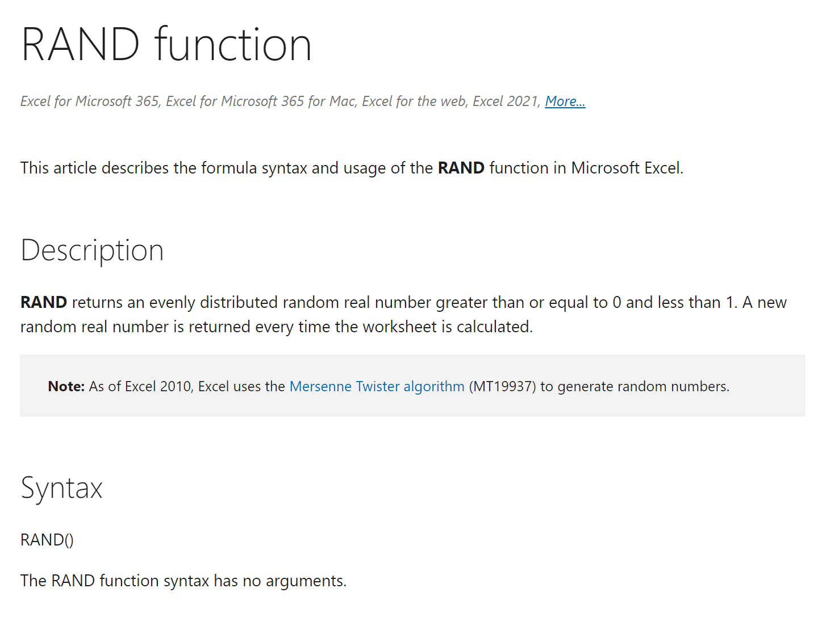
Not all functions are defined equal…
Some have no arguments
https://support.microsoft.com/en-us/office/rand-function-4cbfa695-8869-4788-8d90-021ea9f5be73
Notes:
Ask learner to name a few functions in the chat

Slide 14
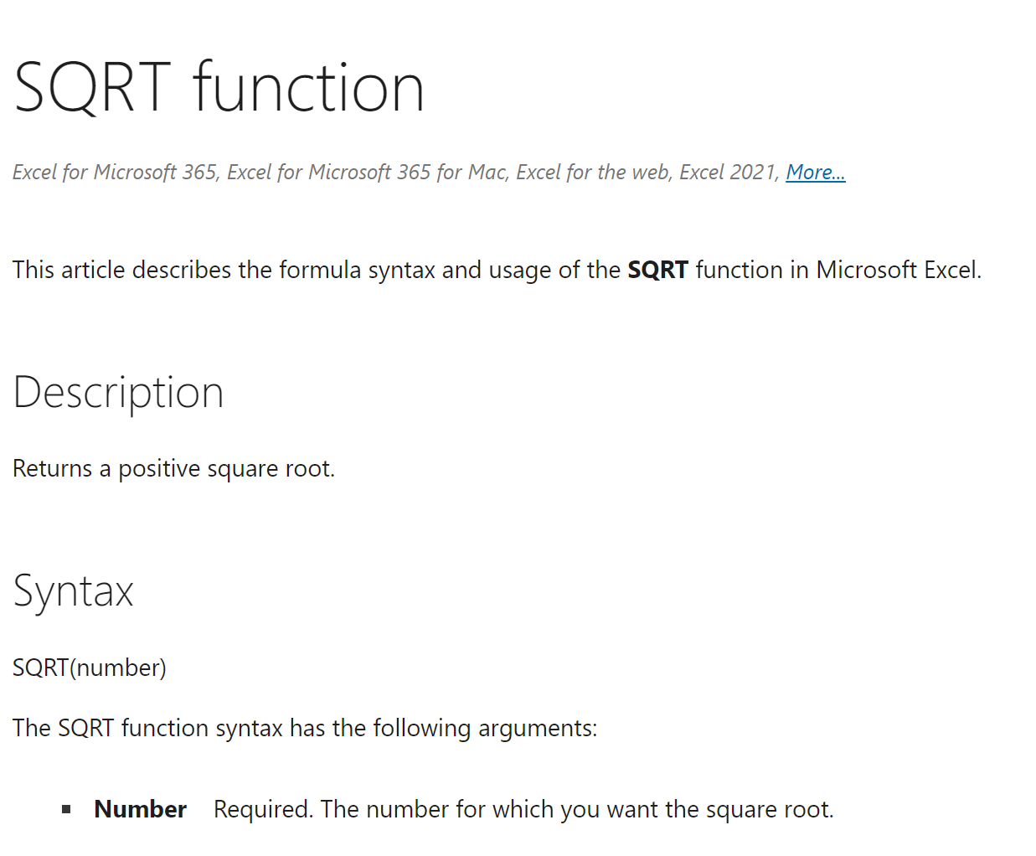
Not all functions are defined equal…
Some always have the same number
https://support.microsoft.com/en-us/office/sqrt-function-654975c2-05c4-4831-9a24-2c65e4040fdf
Notes:
Ask learner to name a few functions in the chat

Slide 15
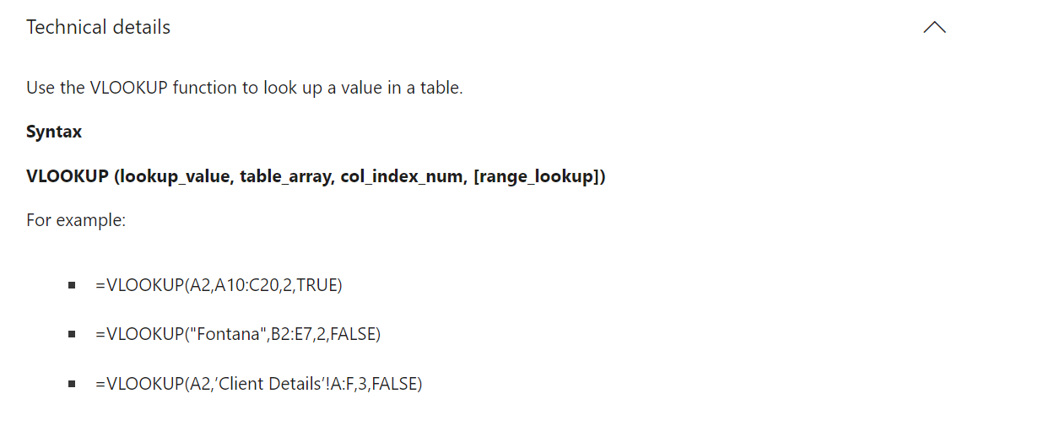
Not all functions are defined equal…
Some have optional and default arguments
https://support.microsoft.com/en-us/office/vlookup-function-0bbc8083-26fe-4963-8ab8-93a18ad188a1
Notes:
Ask learner to name a few functions in the chat

Slide 16
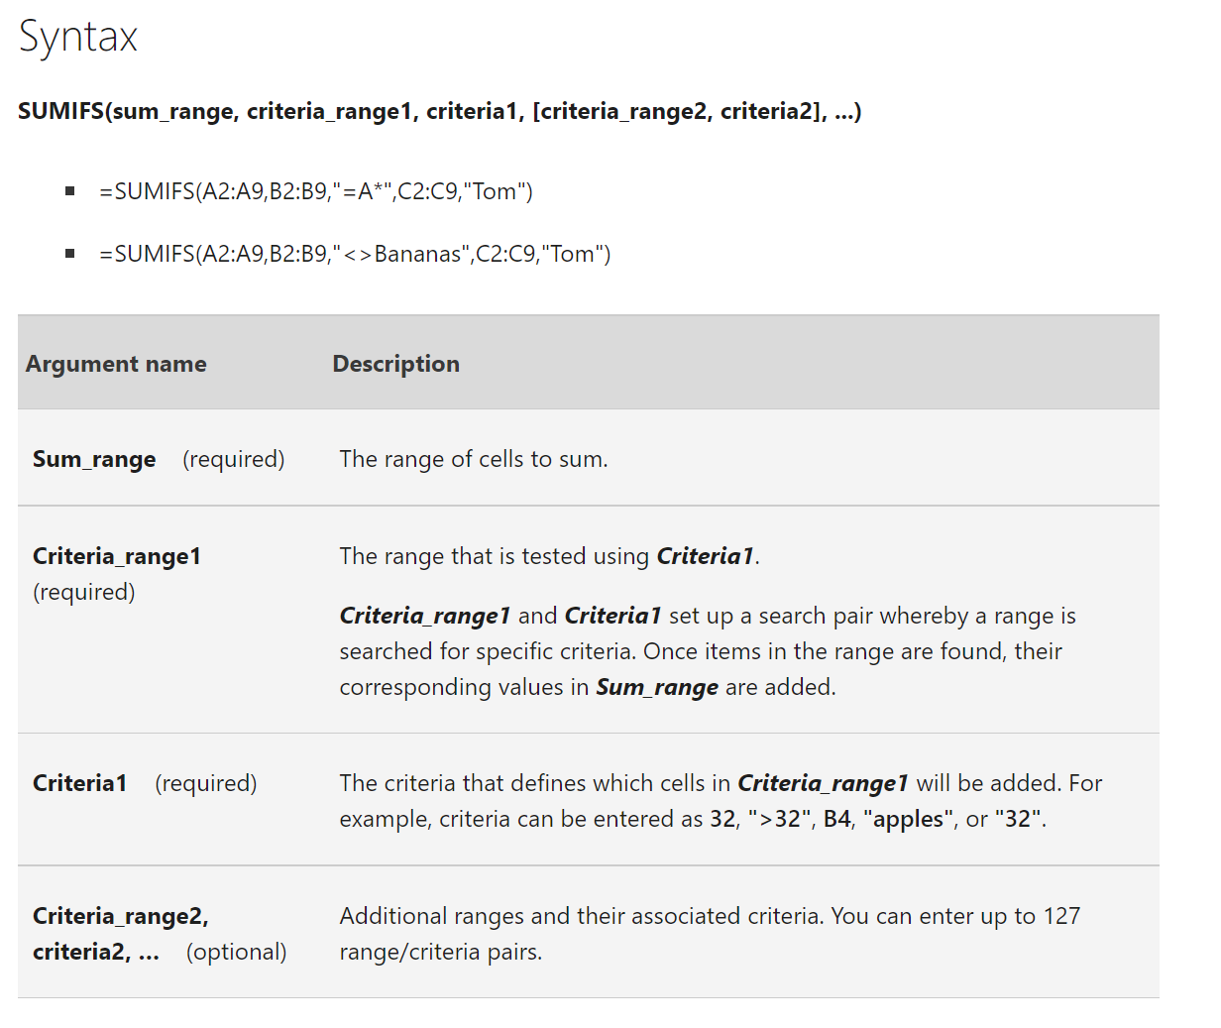
Not all functions are defined equal…
Some have an infinite number (which can be optional!)
https://support.microsoft.com/en-us/office/sumifs-function-c9e748f5-7ea7-455d-9406-611cebce642b
Notes:
Ask learner to name a few functions in the chat

Slide 17
Exercises
T/F: Every Excel formula/function must begin with an = sign.
Are the following formulas or functions:
ABS(-10)
B4<B3
SQRT(10*2)
What is the A4 in the following function called?
FORMULATEXT(A4)

Slide 18
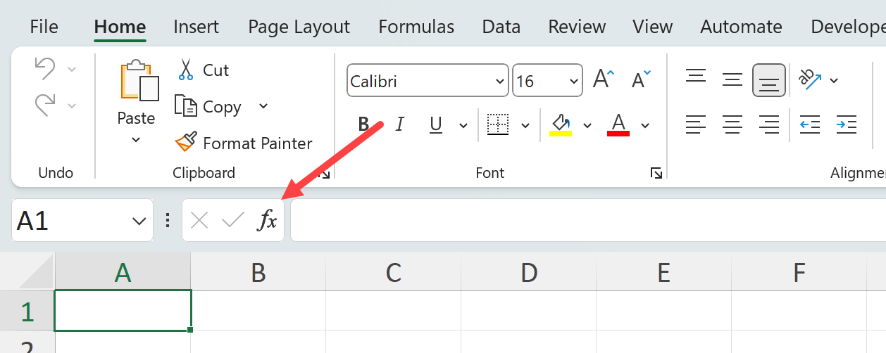
Demo
Worksheet: count-v-counta
Using the Insert Function menu:
Find the results of COUNT() vs COUNTA() for cells A1-A6

Slide 19
Exercise
Learn & teach a new function!
Peruse the Insert Function menu to find an unfamiliar function
Test, evaluate & demonstrate it to class
There are over 450 functions in Excel

Slide 20
Questions?

Slide 21
2. Named ranges and tables

Slide 22

How can we avoid this?
Notes:
Ask learner to name a few functions in the chat

Slide 23
Demo
Worksheet: references
Relative vs absolute references
Creating named ranges

Slide 24
Exercise
Worksheet: ranges-practice
Using named ranges:
Calculate tax * sales amount
Find the % to total NYC population for each borough in each year

Slide 25
Questions?

Slide 26
8 reasons to LOVE Excel tables

Slide 27
Demo
Worksheet: table-time
Why use (and love) Excel tables?

Slide 28
Exercises
Worksheet: mpg
Convert the data to a table called mpg
Create a column which is the average of cty and hwy
Use the INDEX() function to find the position of the trans variable in the column headers
Add a total row to find the average mileage of the vehicles
Remove the header row

Slide 29
Questions?

Slide 30
3. Conditional logic & formulas

Slide 31
IF() statements can only go 2 ways…
Does this condition hold up?
Yes: TRUE
No: FALSE
Notes:
Ask learner to name a few functions in the chat

Slide 32
Demo
Worksheet: commissions
Which reps meet various criteria?
Combine IF() with AND(), OR(), NOT()

Slide 33
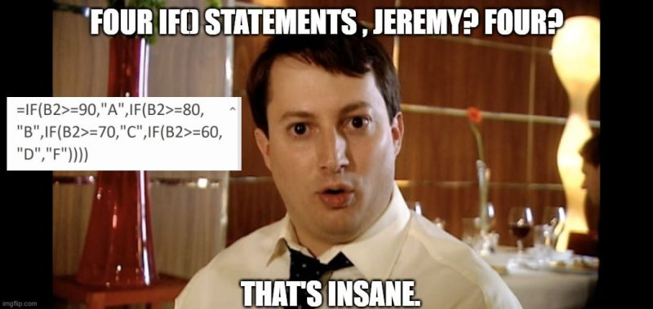
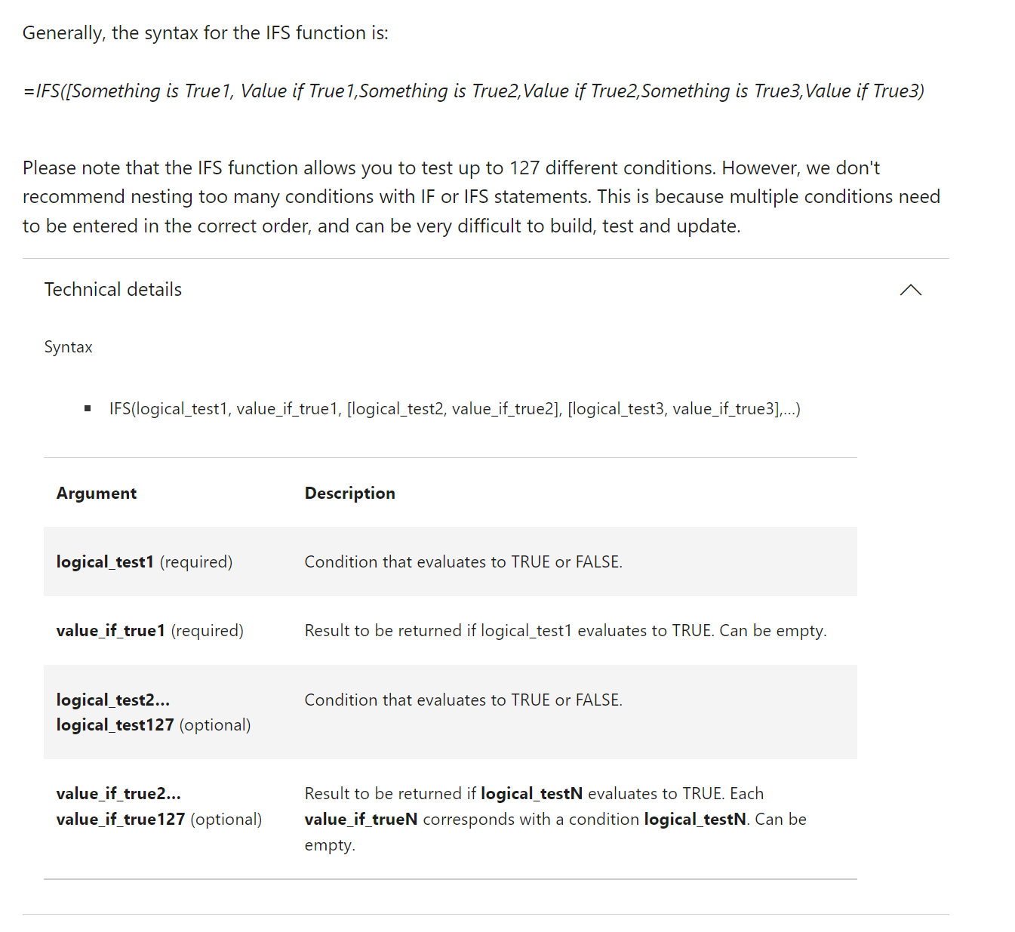
Avoiding nested IF()s with IFS()
https://support.microsoft.com/en-us/office/ifs-function-36329a26-37b2-467c-972b-4a39bd951d45
Notes:
Don’t worry too much about the building blocks right now – I have this in here to gauge everyone’s interest

Slide 34
Avoiding nested IF()s with IFS()
Score | Grade | Grade
89 | B | B
61 | D | D
72 | C | C
95 | A | A
67 | D | D
87 | B | B
62 | D | D
 | =IF(A2 >= 90, "A", IF(A2>=80, "B", IF(A2>=70, "C", IF(A2>=60, "D", "F")))) | =IFS(A2 >= 90,"A", A2 >= 80,"B", A2 >= 70,"C", A2 >= 60,"D", TRUE,"F")
Notes:
Don’t worry too much about the building blocks right now – I have this in here to gauge everyone’s interest

Slide 35
Demo
Worksheet: commissions
Build new

Slide 36
Conditionally aggregating with SUMIFS() and more

Slide 37
What’s wif all the IFS()?
What do we want to do with the data? | By how many conditions? | Formula to use
Add it | 1 | SUMIF()
Add it | More than 1 | SUMIFS()
Count it | 1 | COUNTIF()
Count it | More than 1 | COUNTIFS()
Average it | 1 | AVERAGEIF()
Average it | More than 1 | AVERAGEIFS()
Notes:
Don’t worry too much about the building blocks right now – I have this in here to gauge everyone’s interest

Slide 38
Demo
Worksheet: commissions
Conduct summary analysis on the data: which cells roll up to which summaries?

Slide 39
Exercises
Worksheet: pixar-dreamworks
Find the following with conditional logic:
Write the full studio name Pixar or Dreamworks from P or D
Get the letter grade using the typical grading system
Movies with >$500M gross and >90% rating are “Hits”
Movies with <$350M gross OR <50% rating are “Duds”
Also answer the questions at bottom of worksheet (Hint: Try COUNTIF() for last question!)

Slide 40
4. Dynamic arrays

Slide 41
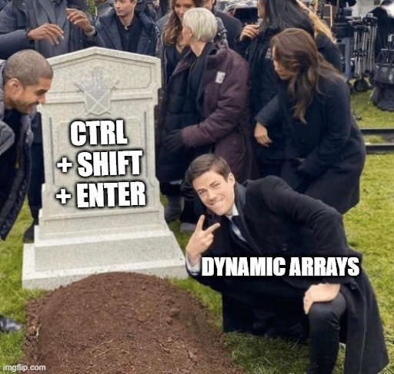
One formula, many cells
Slice and dice
Drill down/roll up
Pivot/Unpivot
Notes:
Don’t worry too much about the building blocks right now – I have this in here to gauge everyone’s interest

Slide 42
The grammar of SQL
Term | What it does | Example
Identifier | Identifies an object (i.e. table, field) | Master
Operator | Takes some action (perform calculation,, rename something) | +, AS
Expression | Applies criteria to data | birthYear > 1960

Slide 43
Making many cells light work
Slice and dice
Drill down/roll up
Pivot/Unpivot
Notes:
Don’t worry too much about the building blocks right now – I have this in here to gauge everyone’s interest

Slide 44

Joining data sources with XLOOKUP()

Slide 45
Questions?

Slide 46
5. LET(), LAMBDA() and the future of Excel

Slide 47
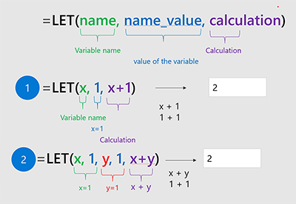
Do not LET() your code repeat!
“The LET function assigns names to calculation results. This allows storing intermediate calculations, values, or defining names inside a formula.”
https://www.microsoft.com/en-us/research/blog/lambda-the-ultimatae-excel-worksheet-function/
Notes:
Don’t worry too much about the building blocks right now – I have this in here to gauge everyone’s interest

Slide 48
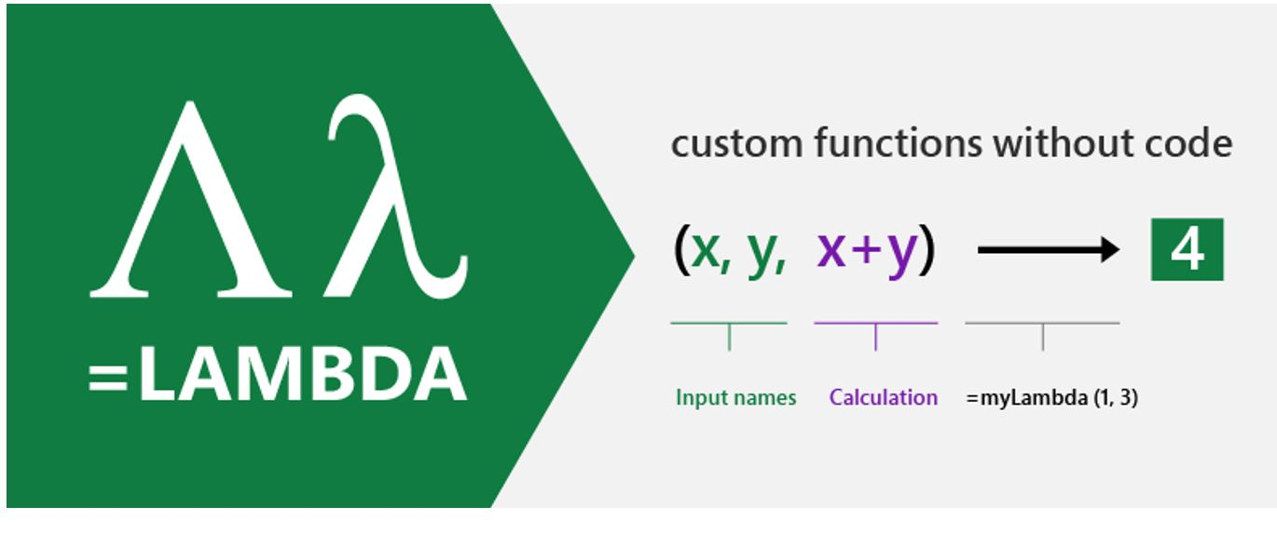
It’s official… Excel IS programming!
“With LAMBDA, Excel has become Turing-complete. You can now, in principle, write any computation in the Excel formula language.”
https://www.microsoft.com/en-us/research/blog/lambda-the-ultimatae-excel-worksheet-function/
Notes:
Don’t worry too much about the building blocks right now – I have this in here to gauge everyone’s interest

Slide 49
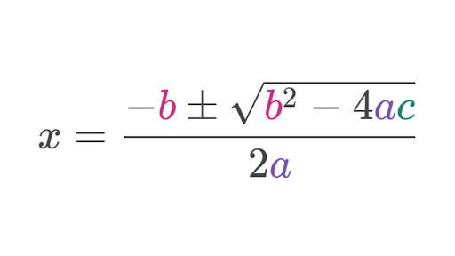
Demo
Worksheet: quadratic
Derive the quadratic formula for a=1, b=-5, c=6 using
LET()
LAMBDA()
LAMBDA() (Name Manager)

Slide 50
Recap: LET() vs LAMBDA()
Method | Pros | Cons
LET() | Easy to set up | Can only return one at a time, difficult to use across workbooks
LAMBDA() | Can reuse across workbook, can return multiple values | Clunky to set up
LAMBDA() (Name manager) | Can do it all! | Difficult to set up

Slide 51
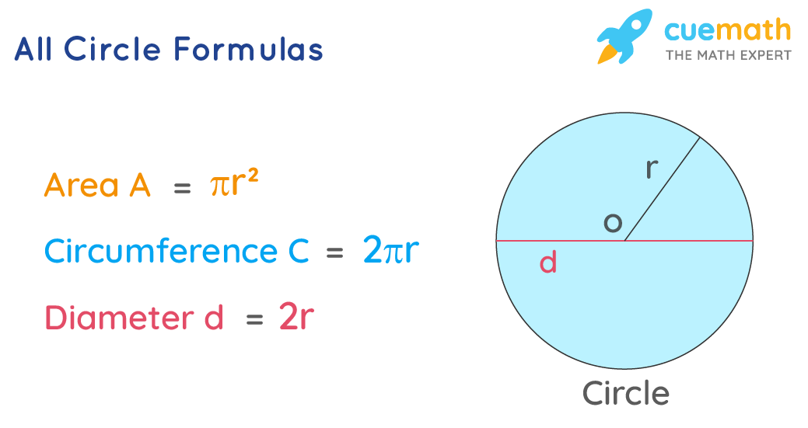
Exercise
Worksheet: circumference
Write a LAMBDA() function called circumference() to get the circumference of a circle
(Hint… use the PI() function!)
https://www.cuemath.com/all-circle-formulas/

Slide 52
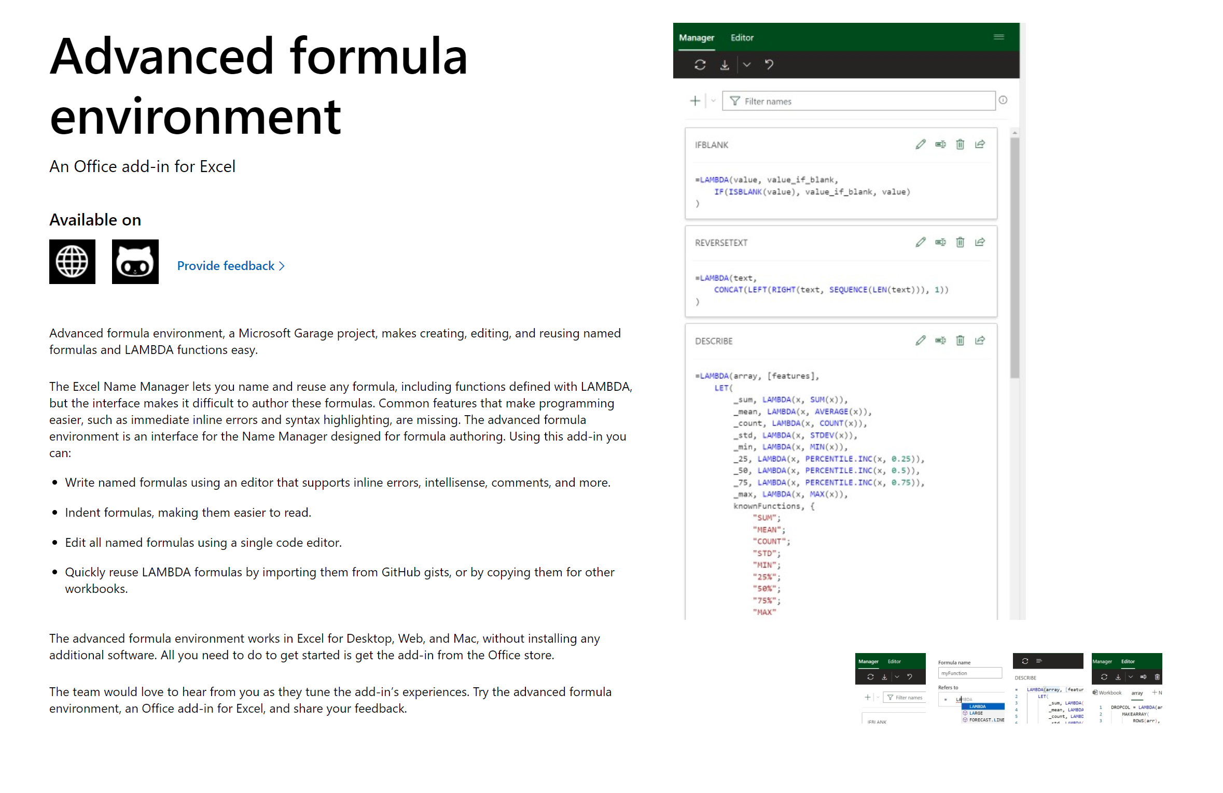
Yes, LAMBDA() can be reused
https://www.microsoft.com/en-us/garage/profiles/advanced-formula-environment-a-microsoft-garage-project/#:~:text=The%20advanced%20formula%20environment%20is,making%20them%20easier%20to%20read.

Slide 53
Making many cells light work
Slice and dice
Drill down/roll up
Pivot/Unpivot
Notes:
Don’t worry too much about the building blocks right now – I have this in here to gauge everyone’s interest

Slide 54
Questions?

Slide 55
4. Formula design & audit

Slide 56
Building readable functions
Add white space
Do not repeat yourself
Ditch nested IF()s
Don’t fear the helper column
No hard codes
Notes:
Ask learner if they would like to see any of these demonstrated.

Slide 57
Auditing formulas
Ctrl + `
FORMULATEXT()
Trace Dependents
F9 & calculation options
Notes:
Ask learners if they would like to see any of these

Slide 58
Questions?

Slide 59

Are you ready for some baseball?
Lahman database: complete player statistics since 1871 plus salaries, Hall of Fame inductions and more!
Download here for SQLite

Slide 60


Onward to SQLite!
+

Slide 61
ARE YOU READY FOR SOME DRILLS?
How many columns are in Managers?
How many of these columns are of type INTEGER?
How many rows does Managers have?

Slide 62
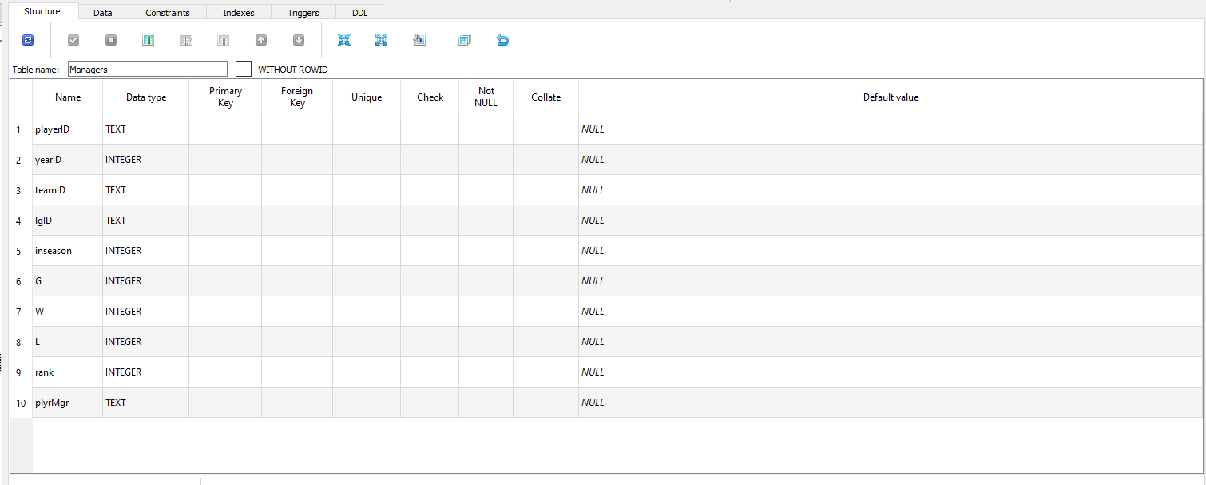
How many columns are in Managers?

Slide 63
2. How many of these columns are of type INTEGER?

Slide 64
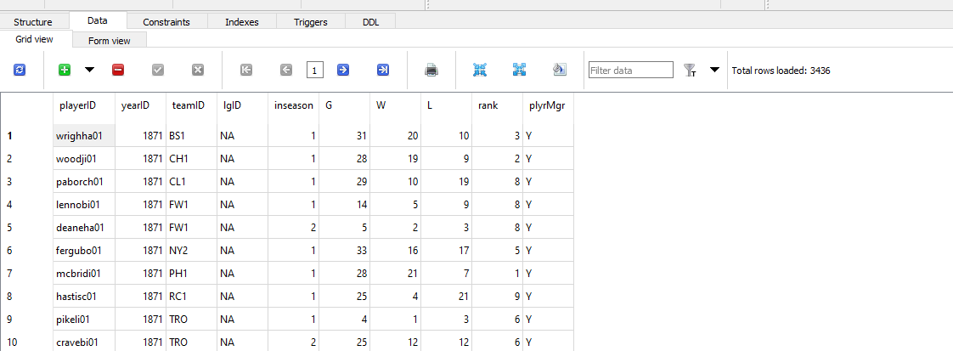
3. How many rows does Managers have?

Slide 65
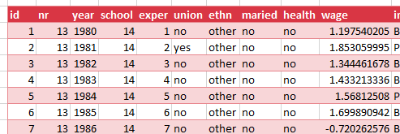
Look to the table
Field/column/attribute
Row/tuple
Value
Table

Slide 66
Questions?

Slide 67
From Excel tables to SQL SELECT

Slide 68
From Excel-ese to SQL-ese
Excel
Data
Calculations
Notes
SQL
Tables
Queries/Scripts
Comments

Slide 69
The grammar of SQL
Term | What it does | Example
Identifier | Identifies an object (i.e. table, field) | Master
Operator | Takes some action (perform calculation,, rename something) | +, AS
Expression | Applies criteria to data | birthYear > 1960

Slide 70

Stylin’ in SQL
0. Good comments starting with –
Each clause on its own line
All operators uppercase (SELECT, ORDER BY, etc.)
Statements end with semicolon (;)

Slide 71
Let’s get coding…
-- List all the tables in our database
SELECT name
FROM sqlite_master
WHERE type='table'
ORDER BY name;
--Get the name and data type from every field in the
--"master" table
PRAGMA table_info(master);

Slide 72
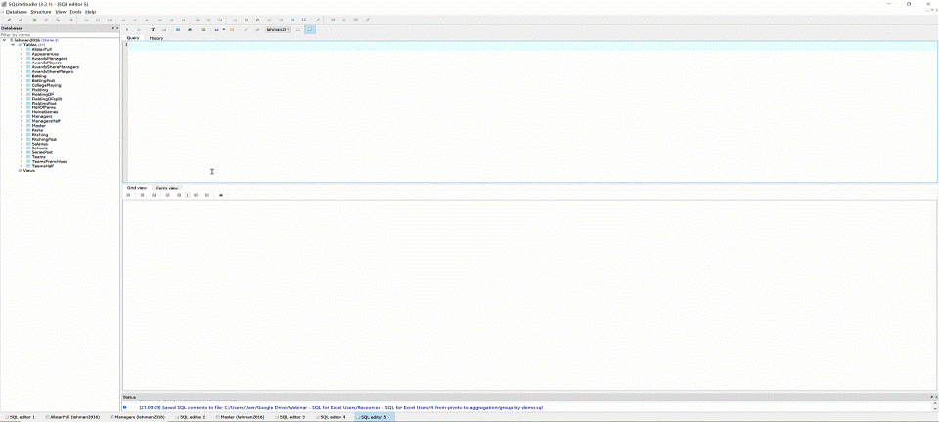
The font is too dang small!

Slide 73
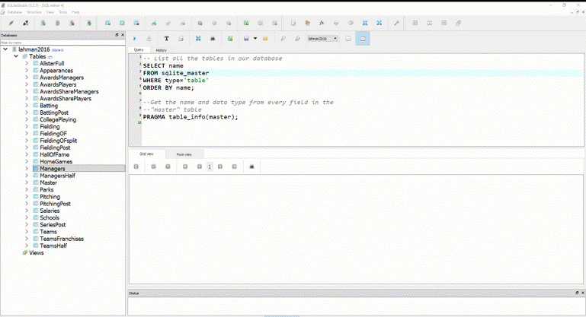
Saving your first .sql script

Slide 74
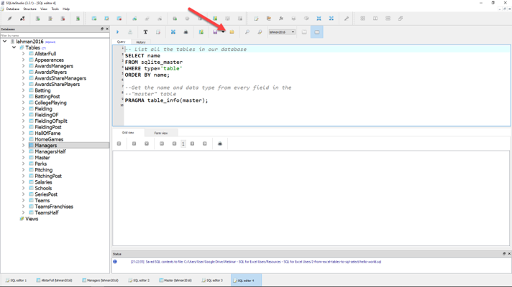
Loading your first .sql script

Slide 75
Demo: sql-tables-example.xlsx

Slide 76
The SQL reader’s digest
Term | What it does
SELECT | Which fields to look for
FROM | Where to look for those fields
WHERE | What criteria those records should meet
GROUP BY | How to aggregate the results
HAVING | What criteria the aggregated results should meet
ORDER BY | How to sort the results
LIMIT | How many records to limit results to

Slide 77
Demo: sql-select-demo.sql

Slide 78
Drills
Using the Teams table:
Select all fields.
Select all fields, first 100 rows.
Select yearID, teamID, W, L.
Select yearID, teamID, and a calculated field win_diff as the difference between W and L.
Create a field team_record such that the first record will read: 1871 Boston Red Stockings: 20-10.

Slide 79
Drills
Using the Teams table:
Select all fields.
Select all fields, first 100 rows.
Select yearID, teamID, W, L.
Select yearID, teamID, and a calculated field win_diff as the difference between W and L.
Create a field team_record such that the first record will read: 1871 Boston Red Stockings: 20-10.
Solutions: sql-select-drills.sql

Slide 80
From Sort & Filter to WHERE and ORDER BY

Slide 81
Demo: sort-filter.xlsx

Slide 82
The SQL reader’s digest
Term | What it does
SELECT | Which fields to look for
FROM | Where to look for those fields
WHERE | What criteria those records should meet
GROUP BY | How to aggregate the results
HAVING | What criteria the aggregated results should meet
ORDER BY | How to sort the results
LIMIT | How many records to limit results to

Slide 83
WHERE: Comparison operators
Operator | Description
= | Equal to
<>, != | Not equal to
> | Greater than
< | Less than
>= | Greater than or equal to
<= | Less than or equal to

Slide 84
WHERE: Logical operators
Operator | Description
BETWEEN | Between an inclusive range
IS NULL | Is a null value
IN | Specifies a range of conditions
OR | Avoids evaluating second condition if first is met
AND | Can be used with other operators
NOT | Excludes results

Slide 85
WHERE LIKE: Wildcard operators
Operator | Description
‘a%’, ‘abc%’ | Returns records that start with a, abc
‘_ _ a’,’_ _ c’ | Returns records with a in 2nd position, abc in 3rd position

Slide 86

A note on NULLs
DOES
Indicate a missing value
DOES NOT
Indicate a value of 0
Indicate why it’s missing

Slide 87
Demo: sort-filter-demo.sql

Slide 88
Drills (continues on next slide)
Using the Managers table:
Select all records, sorted newest to oldest, then by playerID alphabetically.
Select all records between the 1991 and 2000 seasons, sorted high to low by number of games, G.
Create a field, win_diff, calculated as W – L. Return the records with the 25 highest values of win_diff.
How many missing values are in the rank field?

Slide 89
Drills (continued from previous slide)
Using the Managers table:
Select all records, sorted newest to oldest, then by playerID alphabetically.
Select all records between the 1991 and 2000 seasons, sorted high to low by number of games, G.
Create a field, win_diff, calculated as W – L. Return the records with the 25 highest values of win_diff.
How many missing values are in the rank field?

Slide 90
From SUM() and SUMIF() to Aggregation

Slide 91
Demo: aggregation-demo.xlsx

Slide 92
Basic arithmetic functions
Operator | Description
SUM() | Total of records
AVG() | Average of records
MIN() | Minimum value of records
MAX() | Maximum value of records
COUNT() | Count of non-null records

Slide 93
Basic string functions
Operator | Description
CONCAT() | Concatenates fields together
LEFT() | Returns left X values from a string
RIGHT() | Returns right X values from a string
UPPER() | Returns capitalized string
LOWER() | Returns lowercased string

Slide 94
Exploring fields and records
Operator | Description
COUNT(X) | Counts all non-null records of X
DISTINCT X | Returns all distinct values of X
COUNT(DISTINCT X) | Counts distinct values of X

Slide 95
Demo: aggregation-demo.sql

Slide 96
Drills (continues on next slide)
Using the Teams table:
Select the maximum and minimum number of runs.
Select the total number of home runs between 2000 and 2010: total_homers.
Count the number of records where the games played is NULL.
Count the number of records with a recorded attendance.
Return a list of all years reflected in the table.
Count the number of unique franchises since 1915.

Slide 97
Drills (continues on next slide)
Using the Teams table:
Select the maximum and minimum number of runs.
Select the total number of home runs between 2000 and 2010: total_homers.
Count the number of records where the games played is NULL.
Count the number of records with a recorded attendance.
Return a list of all years reflected in the table.
Count the number of unique franchises since 1915.
Solutions: aggregation-drills.sql

Slide 98
From PivotTables to GROUP BY

Slide 99
Demo: group-by-demo.xlsx

Slide 100
The SQL reader’s digest
Term | What it does
SELECT | Which fields to look for
FROM | Where to look for those fields
WHERE | What criteria those records should meet
GROUP BY | How to aggregate the results
HAVING | What criteria the aggregated results should meet
ORDER BY | How to sort the results
LIMIT | How many records to limit results to

Slide 101
Demo: group-by-demo.sql

Slide 102
Drills
Using the Teams table:
Return the largest attendance for each team, sorted high to low.
Find the total number of stolen bases, grouped by year and league.
Find the average number of home runs for each season, keeping only years with an average of 150 home runs or more.

Slide 103
Drills
Using the Teams table:
Return the largest attendance for each team, sorted high to low.
Find the total number of stolen bases, grouped by year and league.
Find the average number of home runs for each season, keeping only years with an average of 150 home runs or more.
Solutions: group-by-drills.sql

Slide 104
Capstone: All clauses in one

Slide 105
The SQL reader’s digest
Term | What it does
SELECT | Which fields to look for
FROM | Where to look for those fields
WHERE | What criteria those records should meet
GROUP BY | How to aggregate the results
HAVING | What criteria the aggregated results should meet
ORDER BY | How to sort the results
LIMIT | How many records to limit results to

Slide 106


Try forgetting now…
Term | What it does
SWEATY | SELECT
FEET | FROM
WILL | WHERE
GIVE | GROUP BY
HORRIBLE | HAVING
ODORS | ORDER BY

Slide 107
Try forgetting now…
Term | What it does
SWEATY | SELECT nameFirst, COUNT(nameFirst)
FEET | FROM Master
WILL | WHERE birthCountry != ‘USA’
GIVE | GROUP BY nameFirst
HORRIBLE | HAVING COUNT(nameFirst) > 1
ODORS | ORDER BY COUNT(nameFirst) DESC;

Slide 108
Drills
Using the Teams table:
Find the maximum number of home runs hit by a team for each year since 1980. Include only those years where fewer than 200 home runs were hit by any team. Sort the results from high to low.
For NL teams that won the World Series that year, what was the maximum number of games won? Include only those teams that won at least 100 games for one of those years. Sort the results from high to low.

Slide 109
Drills
Using the Teams table:
Find the maximum number of home runs hit by a team for each year since 1980. Include only those years where fewer than 200 home runs were hit by any team. Sort the results from high to low.
For NL teams that won the World Series that year, what was the maximum number of games won? Include only those teams that won at least 100 games for one of those years. Sort the results from high to low.
Solutions: sql-all-statements-in-one-drill.sql

Slide 110
From VLOOKUP() to JOIN

Slide 111

How do we get information from more than one table at a time?
What makes a relational database, relational?
https://dev.to/helenanders26/sql-series-all-about-sql-joins-15ol

Slide 112
Demo: vlookup-vs-join.xlsx

Slide 113
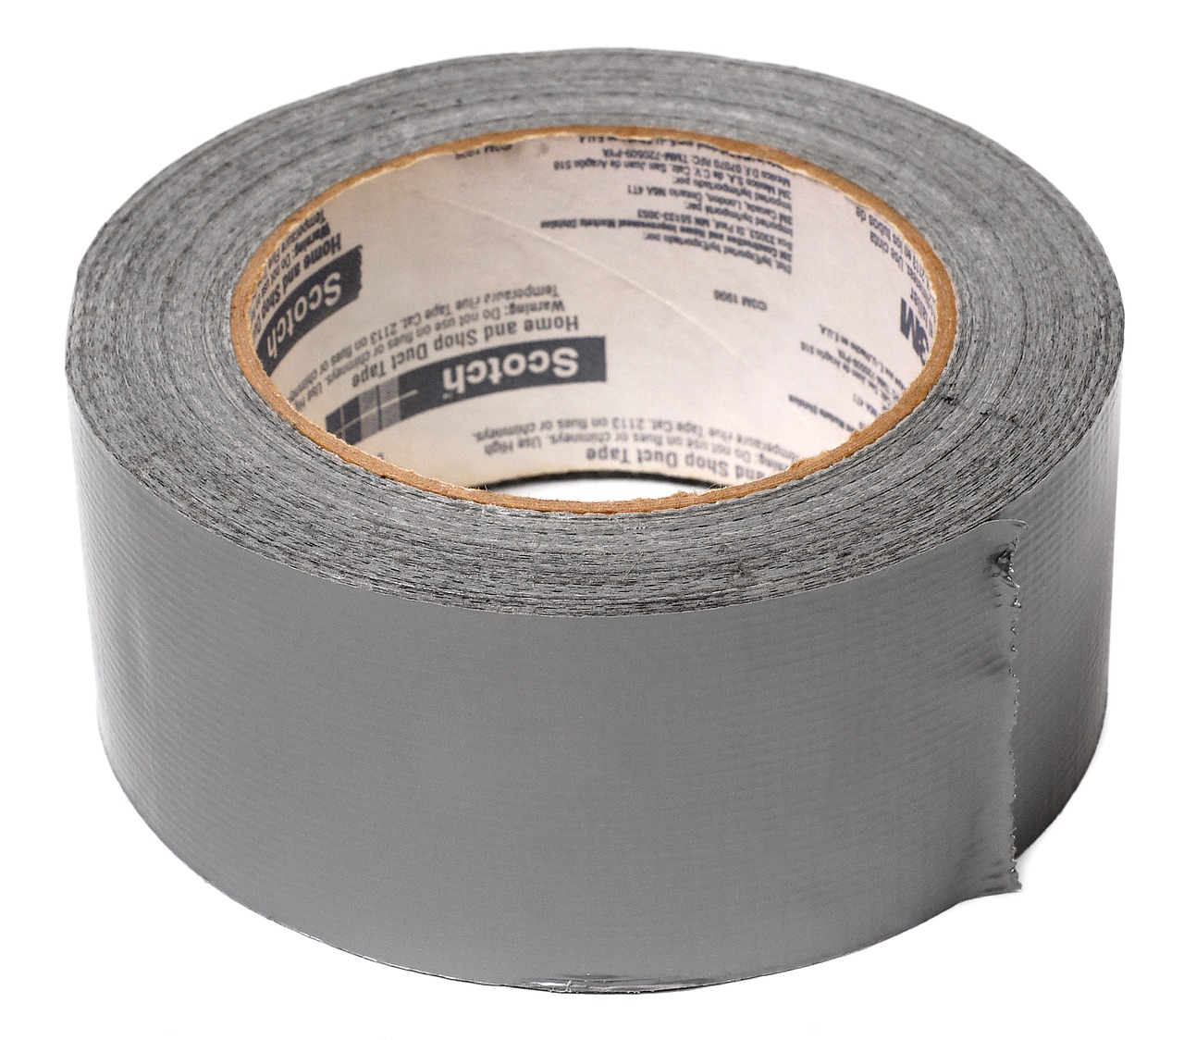

FROM VLOOKUP() Duct Tape to JOIN Blowtorch

Slide 114

Key-lookup
Primary key: Unique, unchanging identifier
Foreign key: References the primary key of another table

Slide 115

Ever been asked for your ID number?
That’s your primary key!

Slide 116
One-to-one relationship

Slide 117
One-to-many relationship

Slide 118
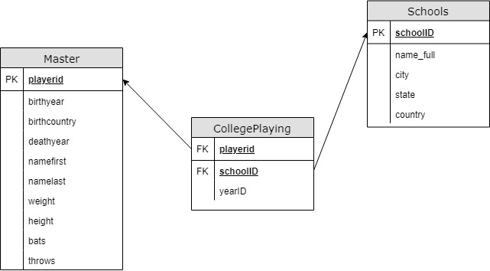
Introducing Schemas

Slide 119
INNER JOIN
Returns records with matching values in both Table A and Table B
TABLE A
TABLE B

Slide 120
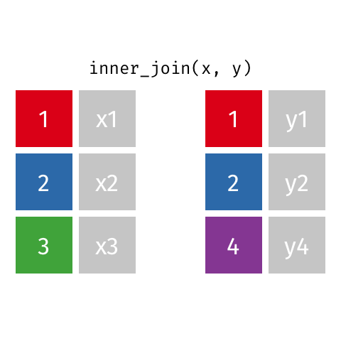
Visualizing an INNER JOIN
https://github.com/gadenbuie/tidyexplain#mutating-joins

Slide 121
Demo: inner-join-demo.sql

Slide 122
Drills
For the Master and HallOfFame tables:
Return a list of unique first and last names for all individuals in HallOfFame
Return first and last names along with the year, votes needed and votes received for all successful HoF inductees
Return the birth year of the oldest individual inducted for each year of HoF inductions. How “old” was each player at induction?

Slide 123
Drills
For the Master and HallOfFame tables:
Return a list of unique first and last names for all individuals in HallOfFame
Return first and last names along with the year, votes needed and votes received for all successful HoF inductees
Return the birth year of the oldest individual inducted for each year of HoF inductions. How “old” was each player at induction?
Solutions: inner-join-drills.sql

Slide 124
LEFT OUTER JOIN
Returns all records from Table A and matching records from Table B. NULL if no match.
TABLE A
TABLE B

Slide 125

Visualizing a LEFT OUTER JOIN
https://github.com/gadenbuie/tidyexplain#mutating-joins

Slide 126
Demo: left-outer-join-demo.sql

Slide 127
Drills
Find the maximum annual salary paid to anyone included in Master, sorted descending by salary.
Keeping the names of all schools listed in Schools, find the first name, last name and years played for all schools (Check CollegePlaying).

Slide 128
Drills
Find the maximum annual salary paid to anyone included in Master, sorted descending by salary.
Keeping the names of all schools listed in Schools, find the first name, last name and years played for all schools (Check CollegePlaying).
Solutions: left-outer-join-drills.sql

Slide 129
From “That’s hard in Excel!” to “That’s easy in SQL!”

Slide 130
Demo: hard-in-excel-easy-in-sql.xlsx

Slide 131
Demo: hard-in-excel-easy-in-sql.sql

Slide 132
CASE expressions
CASE
WHEN condition THEN result-expression
WHEN condition THEN result-expression ...
ELSE result-expression
END AS alias

Slide 133
Subqueries as condition: WHERE
SELECT fields
FROM table
WHERE operator
-- Subquery
(SELECT fields
FROM table);

Slide 134
Common table expressions (CTEs): Expressions acting like tables
WITH
expression_name_1 AS
(CTE query definition 1)
SELECT expression_A, expression_B, ...
FROM expression_name_1

Slide 135
Drills
Using the Teams table:
In 2016, what teams had more wins than the Chicago Cubs (teamID = ‘CHN’?)
Create a field Century which marks records in the 19th Century as 19, 20th as 20 and 21st as 21.
Find the average season minimum attendance since 1990.

Slide 136
Drills
Find the maximum annual salary paid to anyone included in Master, sorted descending by salary.
Keeping the names of all schools listed in Schools, find the first name, last name and years played for all schools (Check CollegePlaying).
Solutions: hard-in-excel-easy-in-sql.sql

Slide 137
Conclusion & resources

Slide 138
Course recap
What has changed your thinking about Excel formulas?
What are you looking forward to using?
What would you like more practice on?
What do you want to learn next?
Notes:
Ask learners if they would like to see any of these

Slide 139

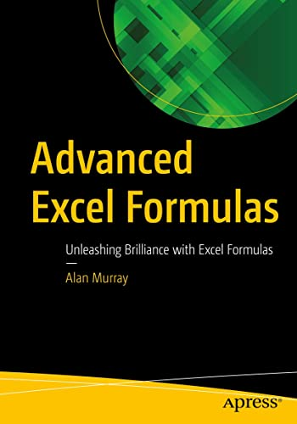
Reading list
Microsoft Excel Formulas and Functions (Office 2021 and Microsoft 365) by Paul McFedries
Advanced Excel Formulas: Unleashing Brilliance with Excel Formulas by Alan Murray

Slide 140
Stay tuned for other courses!
Data wrangling with Power Query
Mastering PivotTable dashboards & reports
Business statistics in Excel
Python analytics for Excel users

Slide 141
Questions?

Slide 142
Find me
georgejmount.com
@gjmount
github.com/summerofgeorge

Slide 143
Thank you

